Slide 1
Smart Emission Control System
By: Chintan Koticha (001267049)
Payal Dodeja (001224158)
Siddhant Chandiwal (001286480)

Slide 2
Problem Statement
In today’s scenario, “Greenhouse gases” possess a grave threat to the environment which is mainly caused by emission of harmful gases like CO2, Nox , HFCs, etc. from automobiles, electrical appliances like refrigerators, air conditioners, etc.
It is necessary to determine and understand the impact of pollution caused on both humans and nature. In order to combat the increasing rage of fast but lethal technical advancements, it is important to maintain the service standards of all automobiles and various appliances.

Slide 3
Approach
EcoSystem model provides with a fundamental structure to build an infrastructure that can help us scrutinize the needed service standards of the system model.
Different fuel sources like solar energy and petrol/diesel were taken into account in order measure the impact on both humans and environment.
The amount of different greenhouse gases emitted was taken into account, analysis was made on the basis of amount released and recovery measures were proposed.

Slide 4
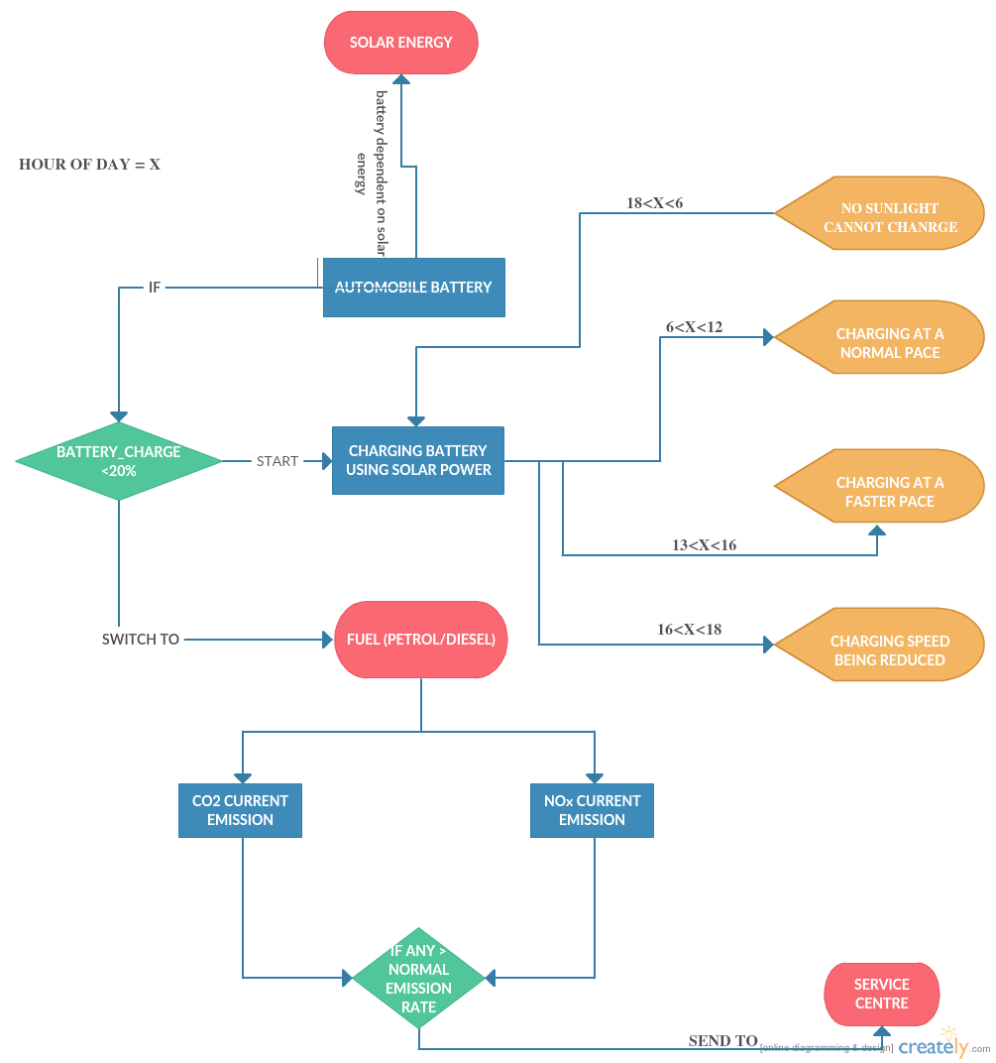
Architecture Scheme

Slide 5
ARCHITECTURE EXPLANATION
If the battery of automobiles that is dependent on solar energy gets discharged below 20 KWh, vehicle is automatically switched to fuel source.
Battery starts re-charging on the basis of “hour of day” criteria, say X:
18<X<6 : No sunlight, can not be charged
6<X<12 : Charging at a normal pace
12<X<16 : Charging at a faster pace
16<X<18 : reduced charging
Use of Petrol/Diesel continues till the battery gets charged.
While being running on fuel, CO2 and Nox emission is noted.
If the current emission is greater than normal emission, the vehicle is sent for service.

Slide 6
Sensors
Four sensors have been implemented in this project:
Solar Energy Sensor : This sensor charges the car batteries using solar energy and helps automobile to run until the time battery drains out to 20% of its total capacity
CO2 Emission Sensor : This sensor keeps track of amount of CO2 released as pollutant from vehicles
Nox Emission Sensor : This sensor keeps track of amount of Nox released as pollutant from vehicles
HFC Emission Sensor : This sensor keeps track of amount of Hydro fluoro carbons emitted from appliances like air conditioners and refrigerators

Slide 7
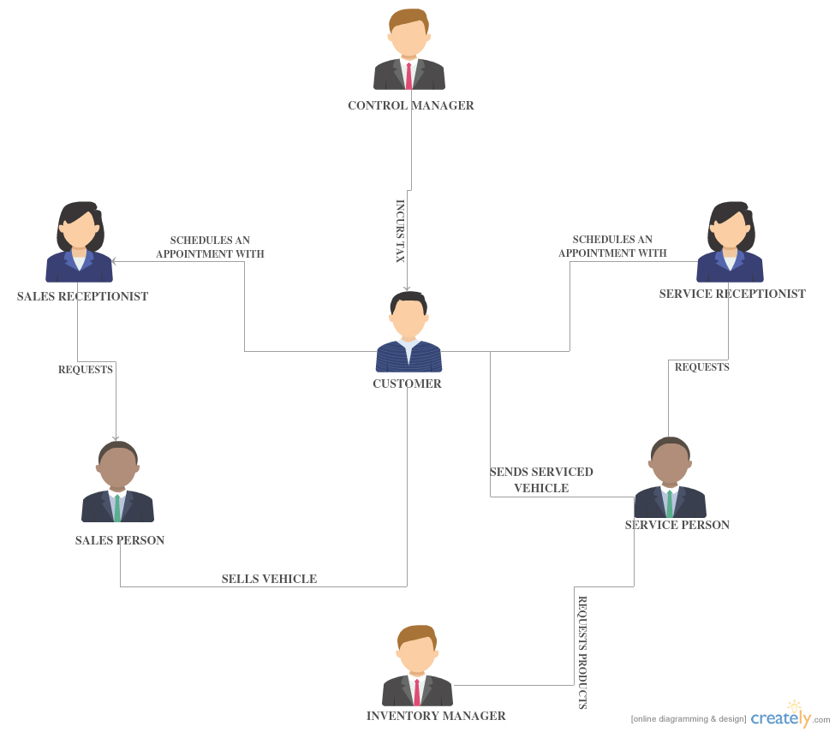
FUNCTIONAL ARCHITECTURE

Slide 8
FUNCTIONAL ARCHITECTURE EXPLANATION
Customer schedules an appointment with the sales receptionist.
Sales receptionist requests the sales person to attend the customer.
Sales person sells the product to the customer.
Customer schedules an appoint with the service receptionist.
Service receptionist requests service person to attend customer’s vehicle.
Service person requests Inventory manager to supply products.
Control manager incurs tax on customer, if any.

Slide 9
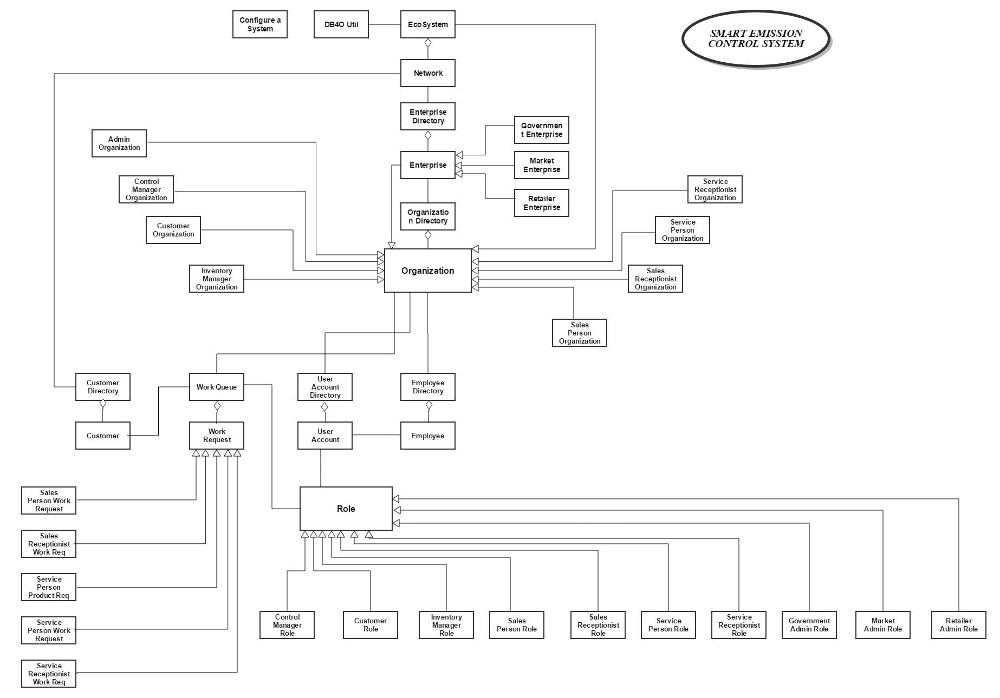
Object Model

Slide 10
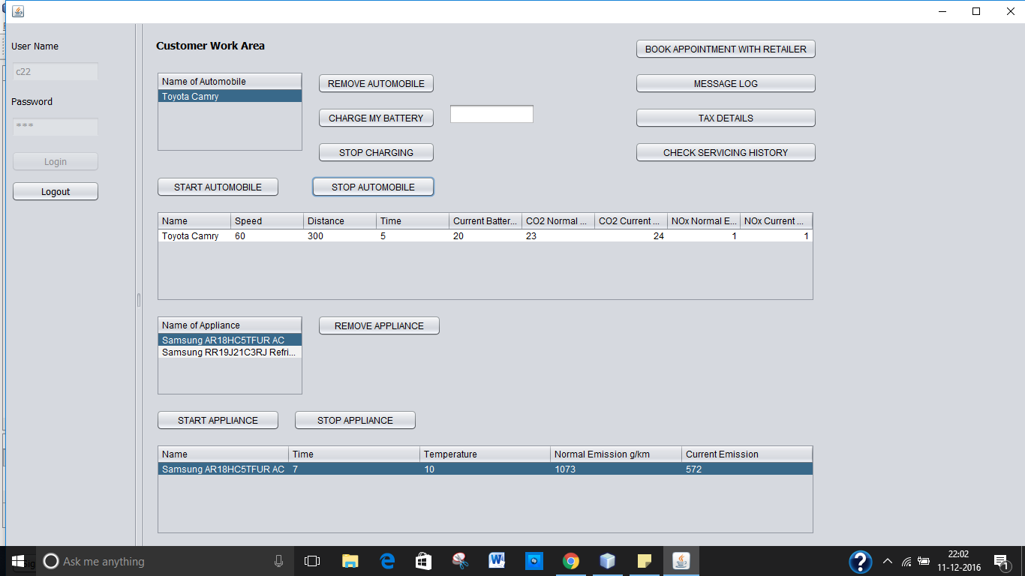
Customer Dashboard

Slide 11
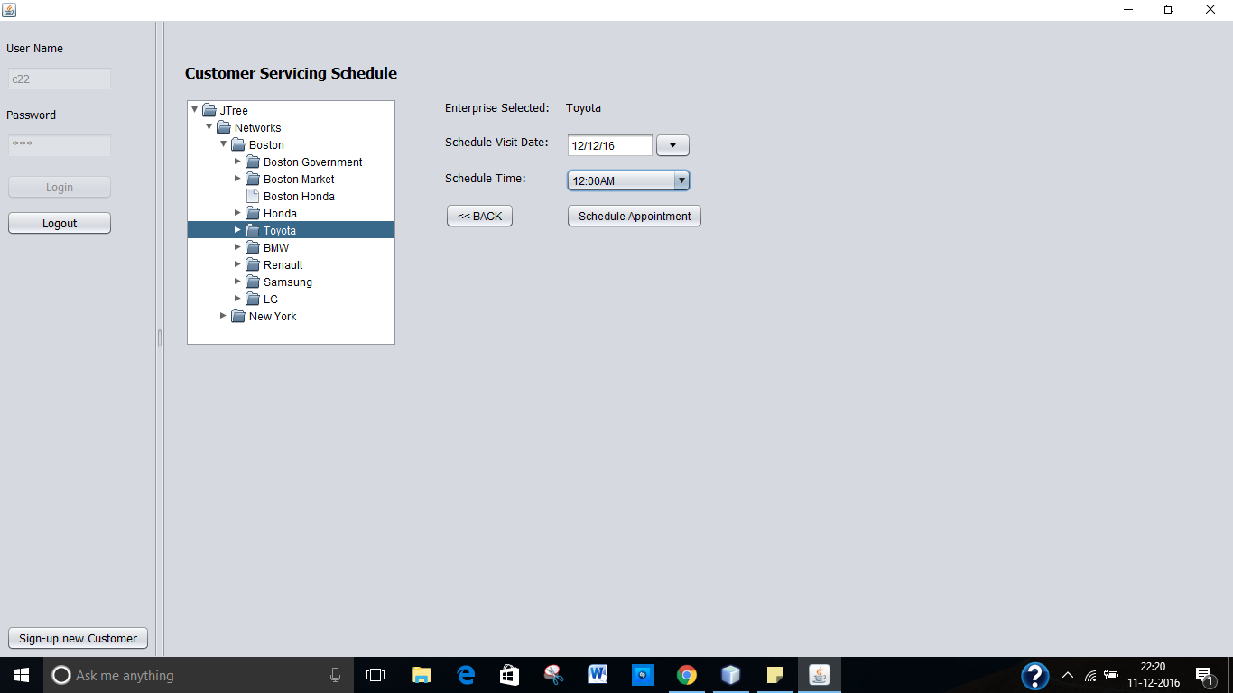
Customer Servicing Schedule

Slide 12
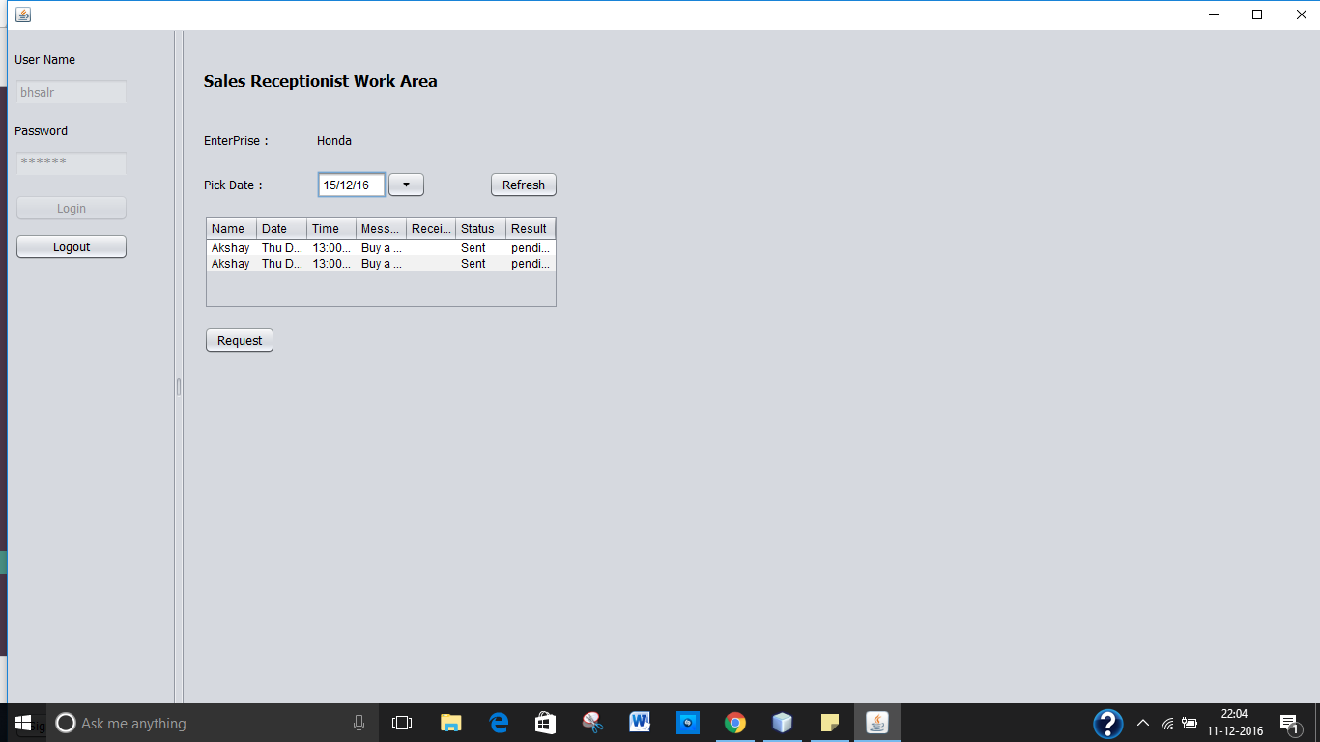
Sales Receptionist Work Area

Slide 13
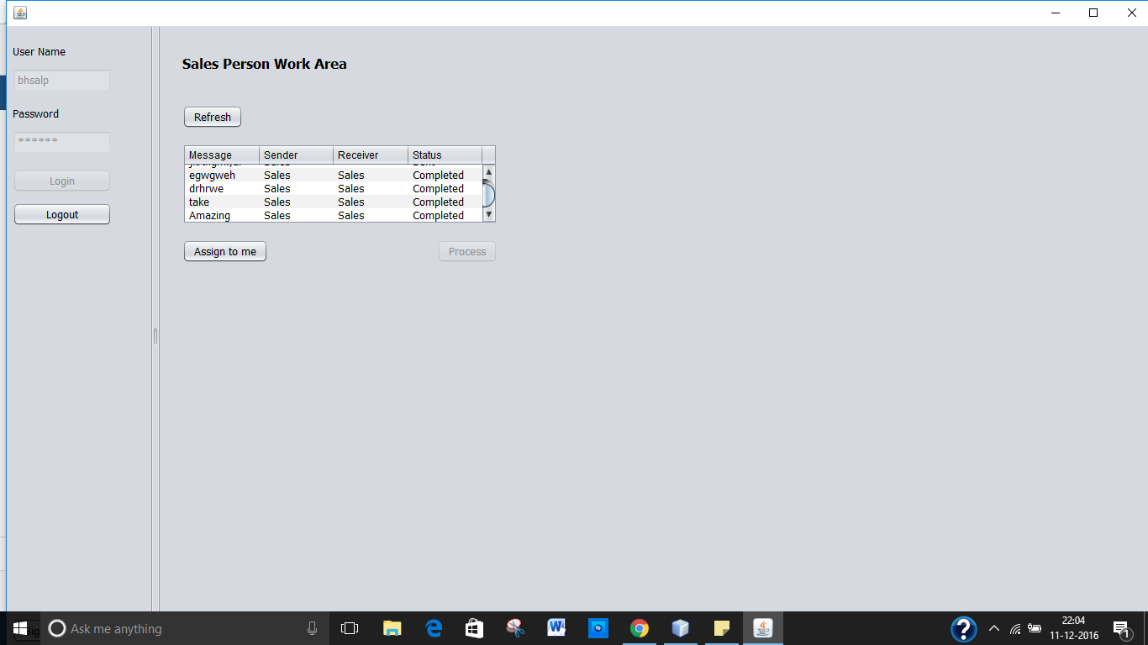
Sales Person Work Area

Slide 14
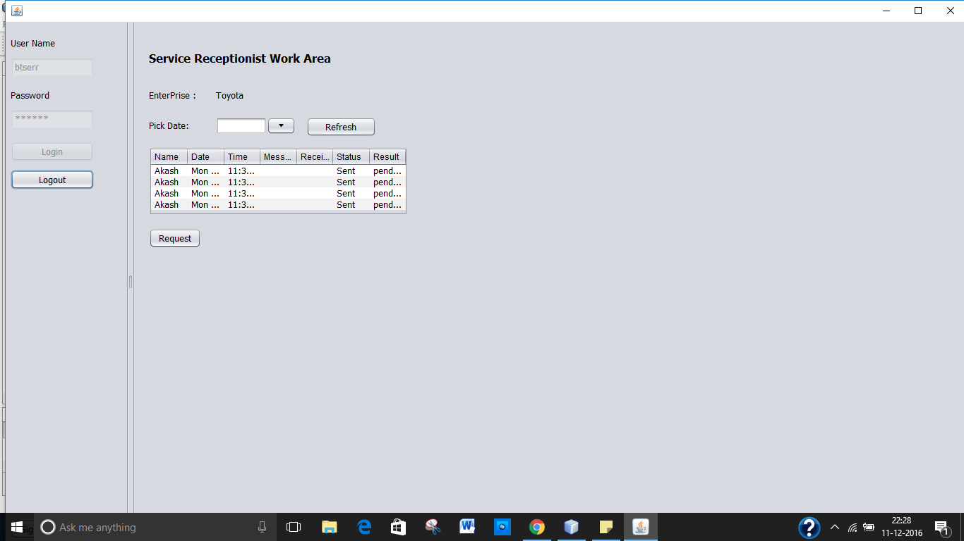
Service Receptionist Work Area

Slide 15
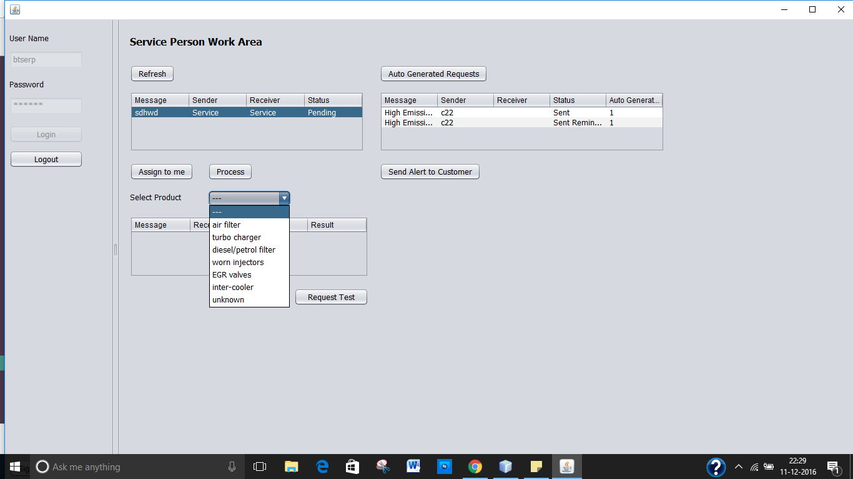
Service Person Work Area

Slide 16
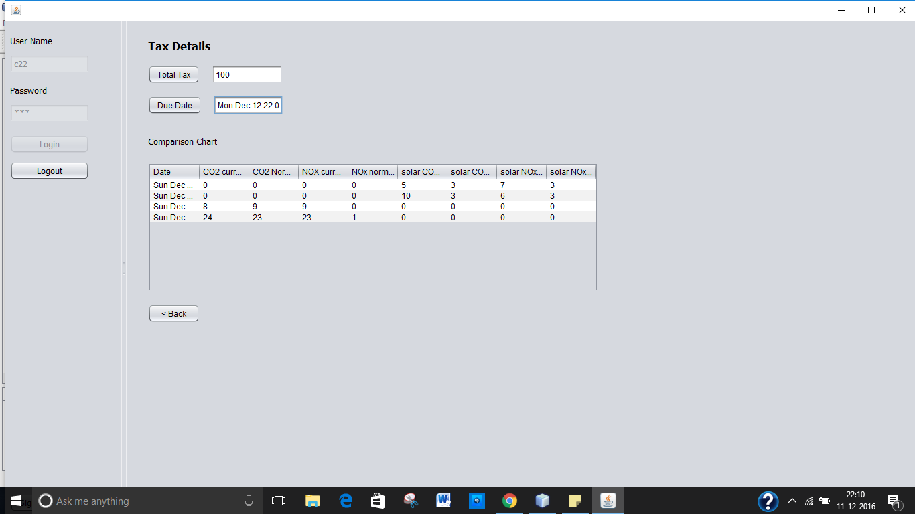
Customer Tax Details

Slide 17
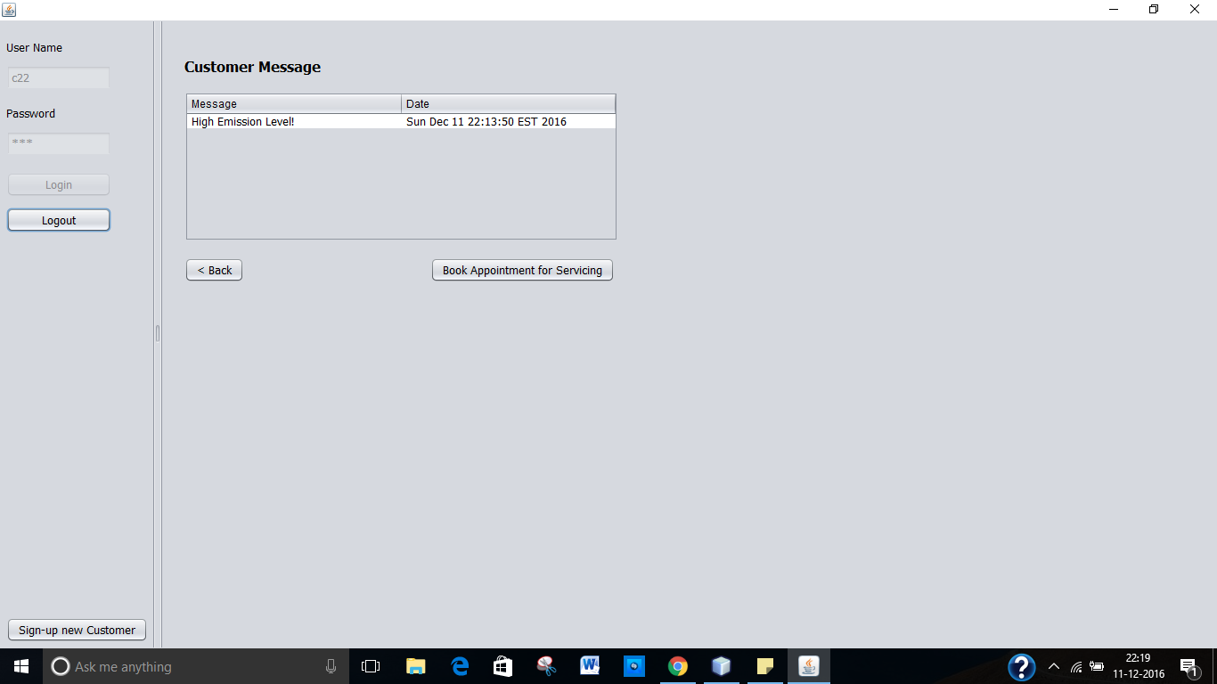
Customer Message Inbox

Slide 18
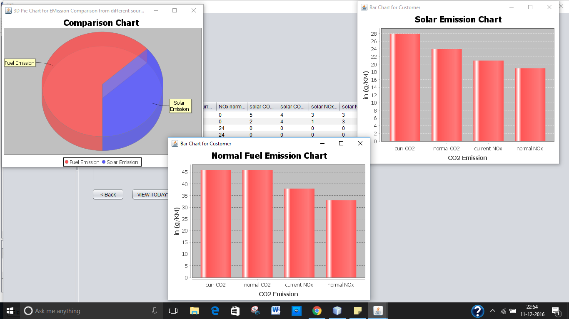
Analysis

Slide 19
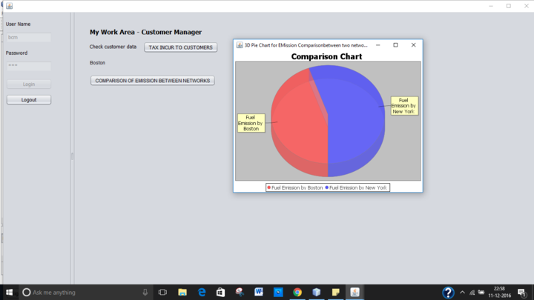
Analysis

Slide 20
FUTURE SCOPE
To monitor all the sensors like Global Energy Sensor , CO2 Sensor and Nox sensor working simultaneously with respect to changes in each other’s status
With the concurrent working of the sensors in the vehicles, amount of pollutants can be recorded, analysis can be made and preventive measures can be taken/suggested in order to reduce the emission of green house gases and save the environment

Slide 21
Thank you !!!

